Slide 1

AXIS BANK…
1. K .ANAND(TEAM LEADER)
2. P. BHARATH
3. G. BHANU PRASAD
4. K. UMAMAHESWARI
5. D. MANI

Slide 2
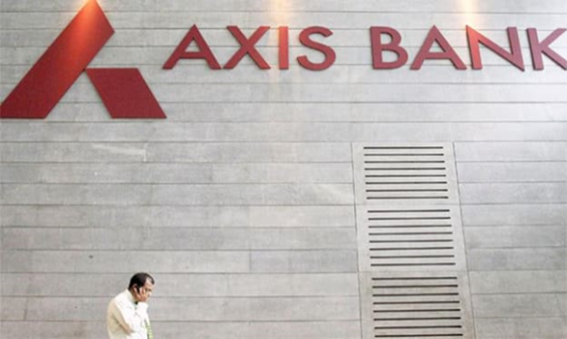
Introduction of axis bank
Axis Bank is a major private sector bank in India, offering a wide range of banking and financial services. Founded in 1993, it provides services to individuals and businesses, with a strong focus on technology and innovation. Axis Bank is known for its extensive branch and ATM network, commitment to sustainability, and dedication to customer service.
Axis Bank provides a comprehensive range of financial services, including retail banking with savings and current accounts, loans, and credit cards. They offer wealth management services, investment options, and portfolio management. Axis Bank excels in digital banking, offering internet and mobile banking, UPI payments, and online trading through Axis Direct. Insurance services include life, general, and travel insurance.

Slide 3
About company mission & values
Mission : Axis Bank's mission is to be a leading and innovative financial solutions provider, with a commitment to creating value for its customers, employees, shareholders, and the communities it serves.
Values:
Customer-Centric: Axis Bank places its customers at the centre of everything it does, striving to meet their financial needs and provide exceptional service.
Teamwork: Axis Bank values collaboration and teamwork, fostering an inclusive and diverse workplace that encourages employees to work together to achieve common goals.
Passion: Axis Bank promotes a passion for excellence and continuous improvement, both in terms of its products and services and the development of its employees.
Performance: The bank emphasizes a culture of high performance, seeking to achieve operational excellence and deliver value to its stakeholders.
Innovation: Axis Bank values innovation and strives to adapt to changing customer needs and market dynamics, leveraging technology and creativity to provide cutting-edge solutions.

Slide 4
Unique Selling Proposition
Axis Bank's Unique Selling Proposition (USP) was based on a combination of factors that set it apart from its competitors in the banking industry. While these factors may have evolved, some of the key elements that contributed to Axis Bank's USP included:
Customer-Centric Approach: Axis Bank has historically focused on providing exceptional customer service and tailoring its products and services to meet the specific financial needs of its diverse customer base. This customer-centric approach was a significant part of its USP.
Innovative Digital Banking: The bank had a strong emphasis on digital banking and innovative technology solutions. Axis Bank invested in cutting-edge technology to offer customers convenient and secure online banking experiences.
Wide Range of Financial Products: Axis Bank offered a comprehensive suite of financial products, including savings and current accounts, loans, credit cards, insurance, investment services, and more. This diversity in its offerings was a part of its USP, catering to a wide range of financial needs.
Strong Corporate Banking: Axis Bank was well-regarded for its corporate banking services, including corporate lending, treasury, and trade finance. This focus on serving the corporate sector was another aspect of its USP.

Slide 5
analyze brand tone and identification of axis bank
1. Tone of the Brand:
Professional
Innovative
Customer-Centric
Reliable
2. Identification:
Logo
Color Scheme
Slogan
Customer Segments
Partnerships and Sponsorships
CSR Initiatives

Slide 6
smart goals and kpis for axis bank
SMART GOALS :
Increase Digital Banking Adoption
Enhance Customer Satisfaction
Expand the Mortgage Portfolio
Strengthen Risk Management
Improve Cross-selling
Enhance Employee Productivity
Key Performance Indicators (KPIs) :
Net Interest Margin (NIM)
Return on Assets (ROA)
Non-Performing Asset (NPA) Ratio
Cost-to-Income Ratio
Customer Satisfaction Score
Loan-to-Deposit Ratio

Slide 7
Buyer’s /audience’s persona
Tech-Savvy Savers:
Demographics: Typically, this persona includes younger customers aged 18-30.
Characteristics: They are digitally literate, value convenience, and prioritize saving and investing.
Financial Needs: They often seek high-yield savings accounts, mobile banking apps, and digital investment options.
Busy Professionals:
Demographics: Often includes working professionals aged 30-45.
Characteristics: They are time-strapped, career-focused, and require easy access to banking services.
Financial Needs: This group may look for efficient online banking, investment advice, and mortgage solutions.
Small Business Owners:
Demographics: Entrepreneurs and small business owners.
Characteristics: They require business banking services and financial solutions tailored to their needs.
Financial Needs: Business loans, merchant services, and cash management.
Experienced Investors:
Demographics: Typically, an older demographic, aged 45 and above.
Characteristics: They have experience with investments and seek wealth management services.
Financial Needs: Wealth management, retirement planning, and investment advisory services.
Students and Young Adults:
Demographics: Includes college students and young adults.
Characteristics: They are often looking for student loans and budget-friendly banking solutions.
Financial Needs: Student loans, basic checking accounts, and educational resources.

Slide 8
Competitor analysis of axis bank
s.no | Competitor company | strengths | weaknesses | opportunities | threats
1. | SBI BANK | SBI is India's biggest bank in terms of market share, sales, and reserves. SBI has been ranked in the Fortune Global 500 list. SBI has made significant investment in technology and digital market. | State Bank of India, India's largest bank, is plagued with a host of problems, mostly relating to wages, perks and pensions, and the latest addition to that list is management high-handedness in HR issues, which is bringing down staff morale. | The increasing adoption of digital banking in India provides opportunities for SBI to expand its customer base and reduce operational costs. SBI can play a significant role in furthering financial inclusion in India, especially in rural and underserved areas. here is potential for SBI to expand its international presence and engage in cross-border banking services. | Economic fluctuations can impact SBI's asset quality and profitability, especially if there is a rise in NPAs during economic downturns. Frequent changes in banking regulations and government policies can create uncertainty and affect SBI's operations.
Competitors swot analysis

Slide 9
s.no | Competitor company | Strenghts | Weaknesses | Opportunities | Threats
2. | HDFC BANK | HDFC Bank is one of the largest and most prominent private sector banks in India, known for its strong presence in retail and corporate banking. HDFC Bank is one of the largest and most prominent private sector banks in India, known for its strong presence in retail and corporate banking. The bank is known for its customer-centric approach, offering a wide range of products and services, including digital banking, to meet customer needs. | The bank has a significant exposure to retail and housing loans, which could pose risks in the event of economic downturns or housing market fluctuations. Like other banks, HDFC Bank may face operational challenges, including the need to upgrade legacy systems and adapt to changing regulatory requirements. including the need to upgrade legacy systems and adapt to changing regulatory requirements. | The increasing adoption of digital banking in India provides opportunities for HDFC Bank to expand its customer base and improve operational efficiency. HDFC Bank can play a significant role in furthering financial inclusion in India, especially in rural and underserved areas. The bank can capitalize on its strong customer base to cross-sell various financial products and services, including insurance, mutual funds, and wealth management. | Economic fluctuations can impact HDFC Bank's asset quality and profitability, especially if there is a rise in NPAs during economic downturns. Frequent changes in banking regulations and government policies can create uncertainty and affect HDFC Bank's operations.

Slide 10
S.NO | Competitor company | Strengths | Weaknesses | Opportunitites | Threats
3. | INDUSIND BANK | IndusInd Bank is known for its customer-centric approach, offering a wide range of financial products and services to meet customer needs. The bank provides a range of services, including retail banking, corporate banking, wealth management, and more, giving it a diverse revenue stream.IndusInd Bank has invested in technology and innovation, which has enabled it to offer digital banking solutions and improve customer experience. The bank has maintained strong capital adequacy ratios, which enhance its financial stability and lending capacity. | Like other banks, IndusInd Bank has faced challenges related to non-performing assets (NPAs), and this could impact its profitability and capital adequacy.Adapting to changing regulatory requirements and upgrading legacy systems can pose operational challenges for the bank.The bank may have a concentration risk in certain segments or products, such as vehicle loans, which could pose risks during economic downturns | The increasing adoption of digital banking in India provides opportunities for IndusInd Bank to expand its customer base and improve operational efficiency.IndusInd Bank can play a significant role in furthering financial inclusion in India, especially in rural and underserved areas. The bank can leverage its customer base to cross-sell various financial products and services, including insurance, mutual funds, and wealth management. IndusInd Bank can explore opportunities for internation. | Economic fluctuations can impact IndusInd Bank's asset quality and profitability, especially if there is a rise in NPAs during economic downturns.Frequent changes in banking regulations and government policies can create uncertainty and affect IndusInd Bank's operations. Competition: The presence of both domestic and foreign banks in india.

Slide 11
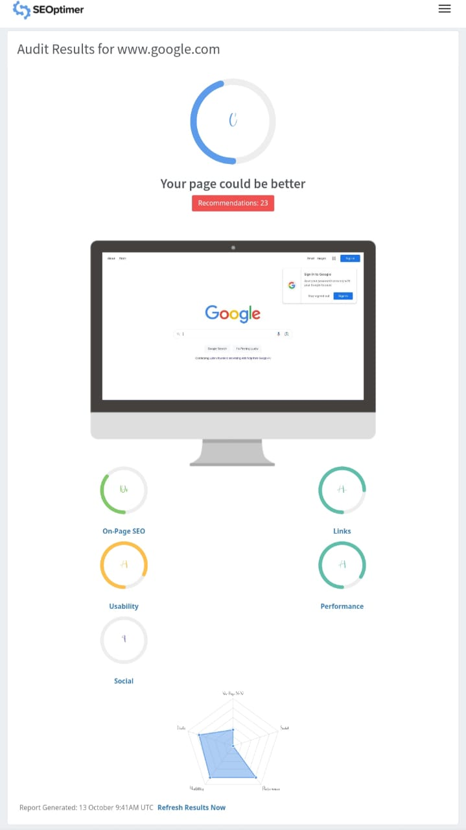
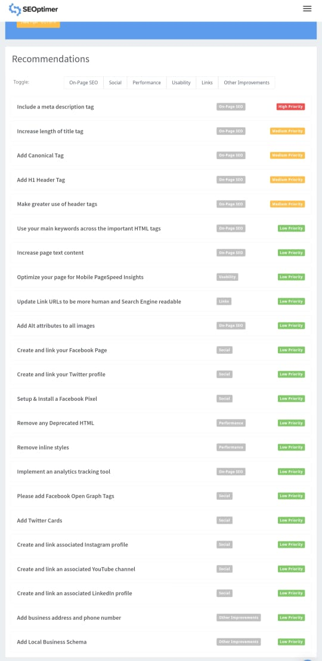
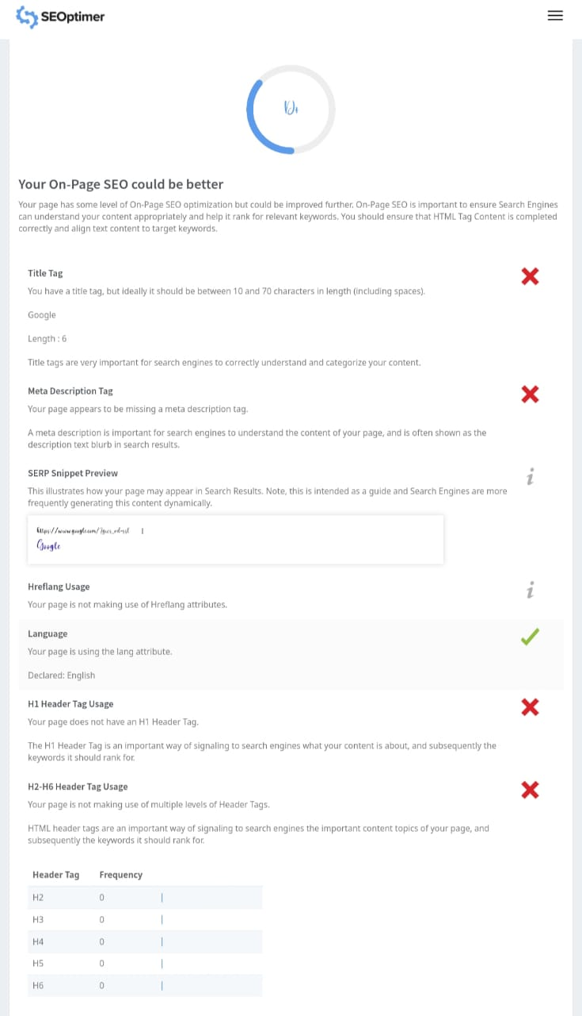
SEO AUDIT

Slide 12
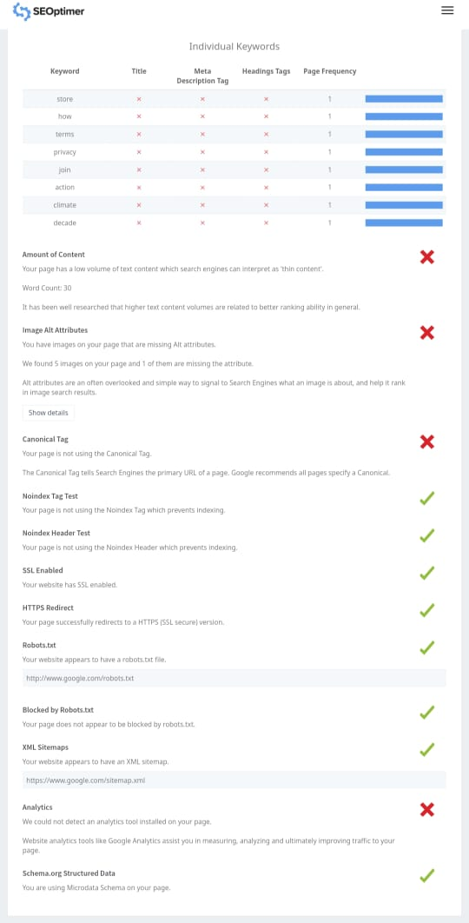
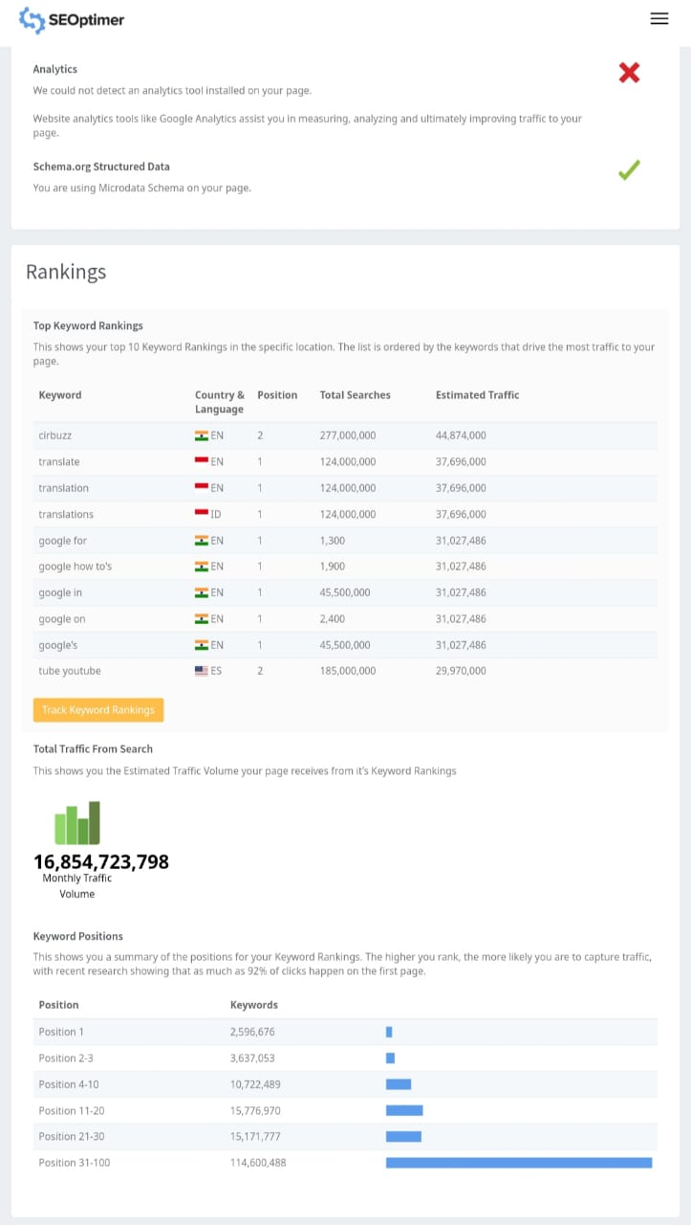
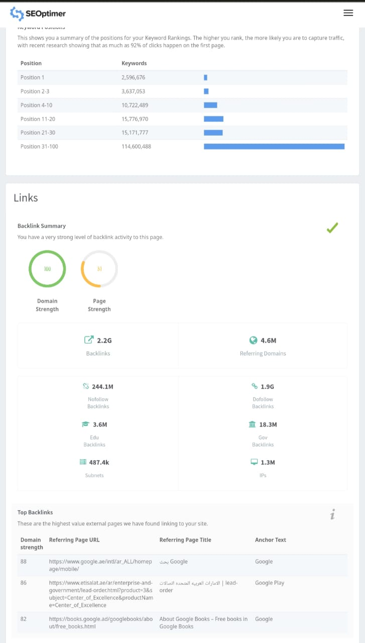

Slide 13
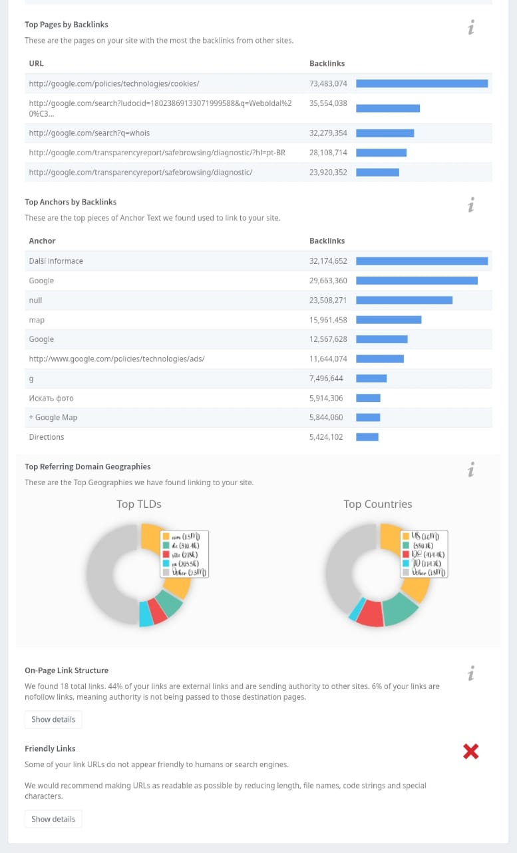
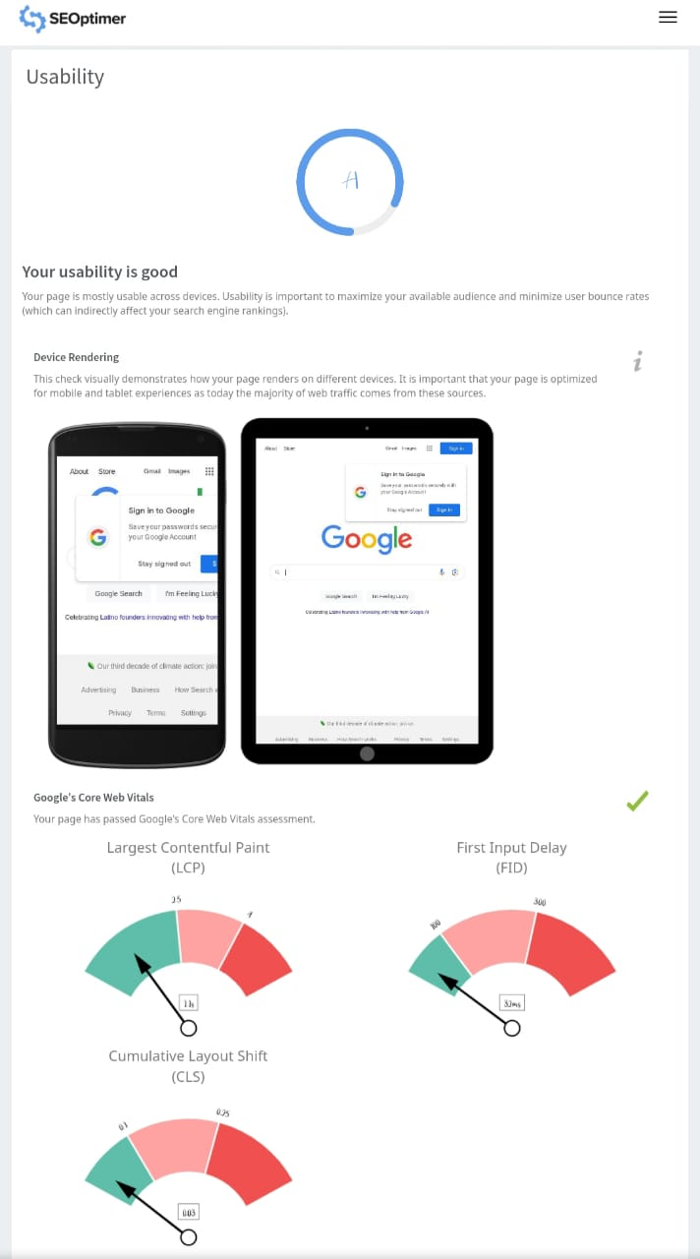
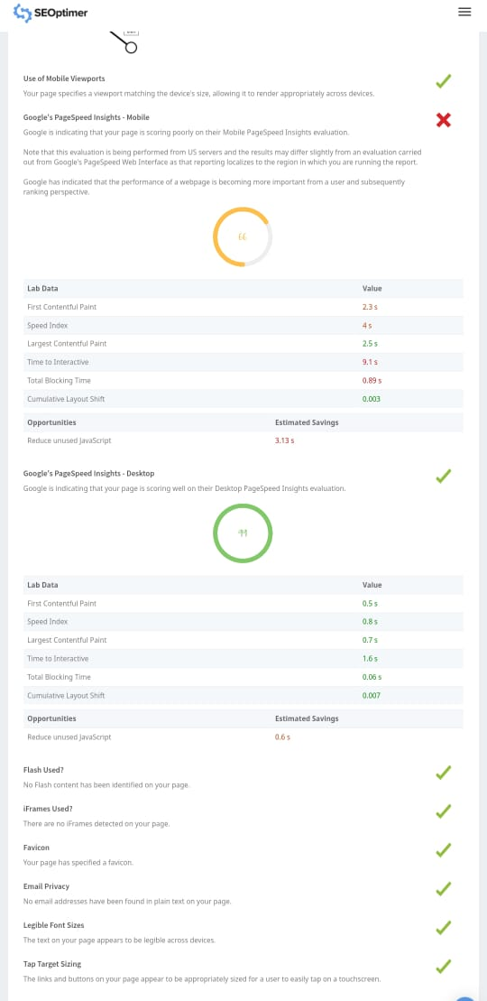

Slide 14
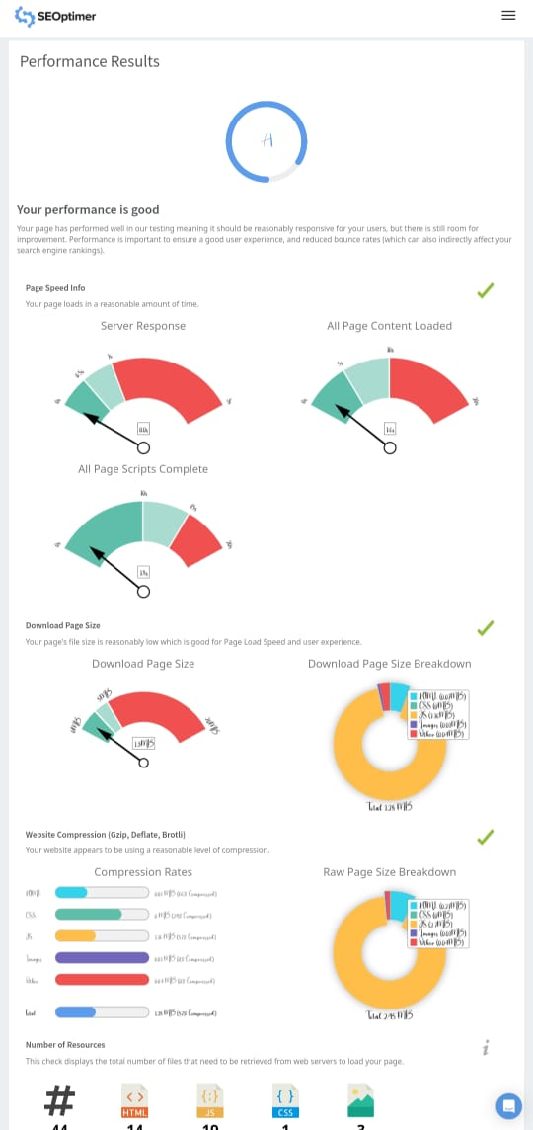
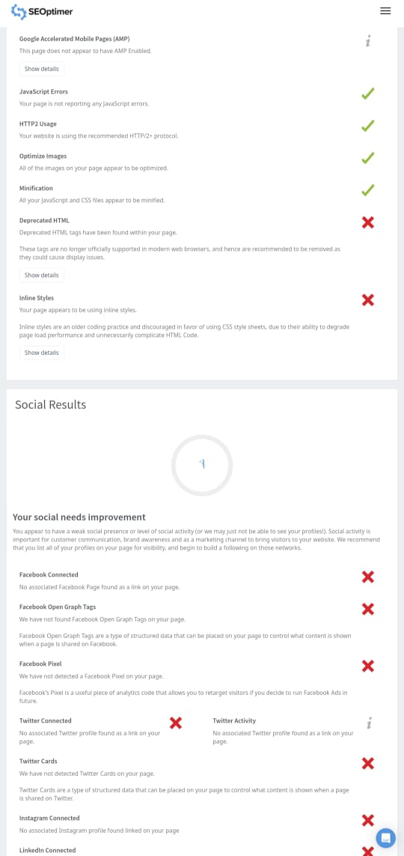
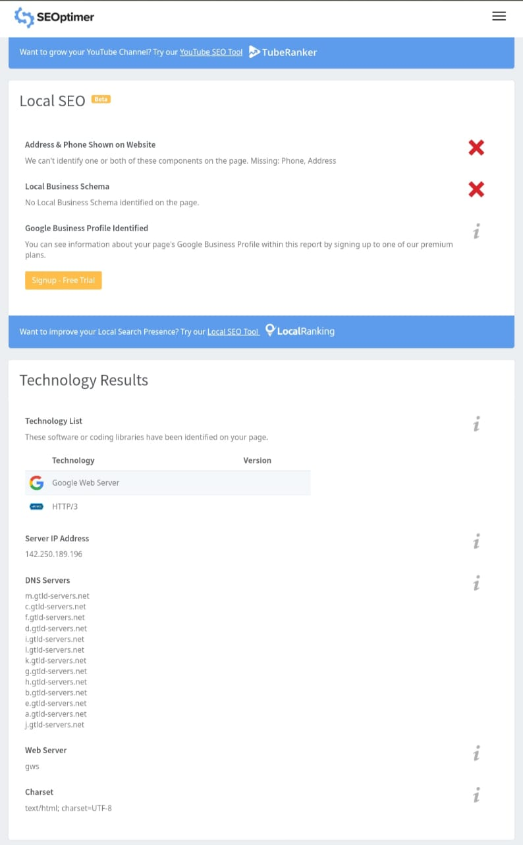

Slide 15
Keyword research
KEYWORDS | VOLUME | COMPETITION | KEI
Axis bank customer service | 400 | 5 | 2398
axis bank career | 360 | 11 | 487
Axis bank near me | 420 | 6 | 1679
Axis bank ifsc code | 1000 | 11 | 571
axis bank netbanking login | 510 | 13 | 369
axis bank internet banking | 2800 | 13 | 470
axis bank nri customer care | 360 | 14 | 487ś

Slide 16
CONTENT IDEA AND GENERATION:
SUNDAY | MONDAY | TUESDAY | WEDNESDAY | THURSDAY | FRIDAY | SATURDAY
 |  |  |  | 12 | 13 | 14
 |  |  |  | Marketing meeting | Briefing about targeting sales | Connecting with customers
15 | 16 | 17 | 18 | 19 | 20 | 21
 | campaign | New blogs | Instagram chat | Group engagement | E- Book | Campaign
22 | 23 | 24 | 25 | 26 | 27 | 28
 | Holiday | Holiday | Holiday | Facebook | Twitter promotion | Product launch
29 | 30 | 31
 | Twitter chat | Others

Slide 17
Content creation and curation
Content Creation for Axis Bank*: - Develop informative articles, blog posts, and videos related to banking, financial planning, and investment. - Highlight the bank's products and services through engaging and educational content. - Produce content about banking industry trends, financial advice, and updates on the bank's offerings.
*Content Curation for Axis Bank*: - Share news articles related to the banking and finance industry, highlighting key trends and developments. - Curate user-generated content, such as customer testimonials and success stories. - Retweet or share content from reputable sources about financial literacy and investment opportunities.
Maintain Brand Consistency*: - Ensure that all content aligns with Axis Bank's brand guidelines and messaging. - Use the bank's branding elements, including logos and color schemes, to create a consistent visual identity
*Engage with the Audience*: - Respond to comments and messages promptly to build a strong online community. - Encourage user-generated content by running campaigns or contests.
Compliance and Regulation*: - Be mindful of the financial regulations and guidelines applicable to banking content to avoid legal issues.

Slide 18


Poster design

Slide 19
Instagram Reel
This is your brand reel link :
https://www.instagram.com/reel/CyVkDtLypdW/?igshid=MzRlODBiNWFlZA==

Slide 20
Team contribution to PPT
I am very thankful to my teams active participation in this ppt.
I am K.Anand the team leader of this group I have collected the information about axis and created slides on introduction and mission and values of the company.
My team member P. Bharath collected information about seo audit and keywords. He collected pictures of seo audit of axis bank and key of the axis bank and smart goals and kips and converted them in slides.
Another member G. Bhanu prasad gathered information about Competitor analysis of axis bank of three brands and converted them to box matter.

Slide 21
D. Mani collected information about Unique Selling Proposition and analyse brand tone and identification of axis bank.
K. Umamaheswari gathered information about Content idea and generation and curation .
We all maked the reel and uploaded the reel and given the link in the slide.

Slide 22
Thanks for
courtesy

